Slide 1
Detecting Fake News
Hariz Mohd Rani Hisham, Kevin Chang, Dang Bich Thuy Le, Qing Zhang, Tam Nguyen

Slide 2
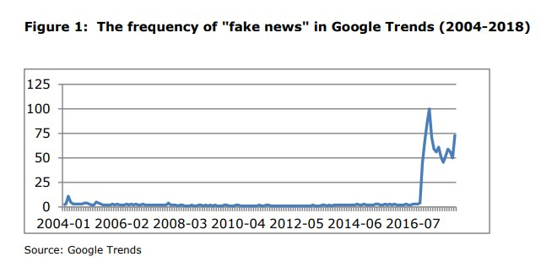
What is fake news?
“Fake news”: defined as “fabricated information that mimics news media content in form but not in organizational process or intent”.
The terms ‘fake news’ and ‘alternative facts’ entered the lexicon during the 2016 presidential election.
90% people have heard the term ‘fake news’ and 80% have heard of ‘alternative facts.’
58% believe it is easier for people to get away with saying things that are not truthful.
Source: Murphy Mark. STUDY: Fake News Hits The Workplace. 2017. www.leadershipiq.com
Notes:
Tammy

Slide 3
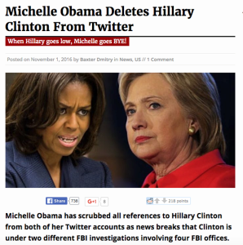
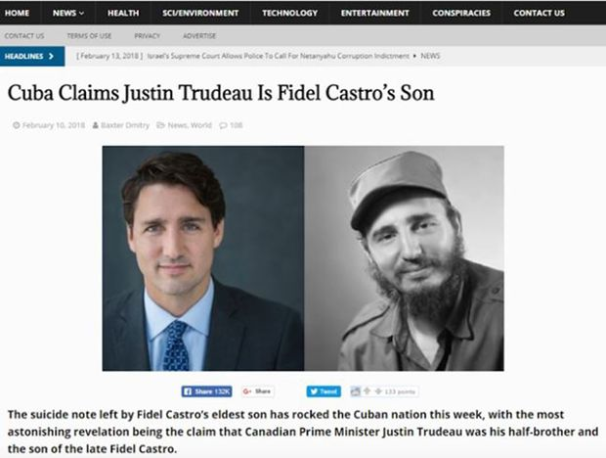
What it looks like
Notes:
Tammy

Slide 4
Why
this problem?
Reliable information is vital to an effective democracy.
False information can affect people’s beliefs and behavior.
False information can be exploited for unethical purposes or malicious intents.
Fake news spreads faster to wider audiences due to social media.
Analysis found that it took the truth approximately six times as long as falsehood to reach 1,500 people and 20 times as long as falsehood to reach a cascade depth of ten.
False news was 70% more likely to be retweeted than the truth. (Vosoughi et al., 2018)
Source: Soroush Vosoughi, Deb Roy, and Sinan Aral. 2018. The spread of true and false news online. Science, 359(6380):1146–1151.
Notes:
Tammy
There are strong indications that false information was weaponized at an unprecedented scale during the 2016 U.S. presidential campaign.

Slide 5
Challenges of detecting fake
news
Manual checking is slow and ineffective in terms of timely delivery.
Automatic fact-checking is low in accuracy and is based on medium-level labels.
These mediums are incomplete and get outdated quickly.
Fake News and Satire are difficult to differentiate.
Notes:
Tammy

Slide 6
Past studies
Predicting FACTUALITY of reporting and BIAS of news media by characterizing them as a whole.
Method: experiment with large list of new websites & rich sets of features derived from
Samples of articles from target news medium
Its Wikipedia page
Its Twitter account
Structure of its URL
Information about Web traffic it attract
Results:
Textual features extracted from the ARTICLES yielded the best performance on factuality and bias → title is not enough, need to analyze contents of target website.
Wikipedia features perform well for bias, but less useful for factuality.
Twitter features perform moderately for factuality and poorly for bias
URL features are better used for factuality rather than bias prediction.
MIT research:
Predicting Factuality of Reporting and Bias of News Media Sources
(Ramy Baly, Georgi Karadzhov, Dimitar Alexandrov, James Glass, Preslav Nakov)
Notes:
Thuy

Slide 7
Our study
What are the textual features in articles that best predict the FAKE NEWS in term of analyzing contents?
Linguistic features based on the use of specific words
Which are the best models to predict FAKE NEWS?
Stem vs Lemmatization
Sampling with SMOTE vs no sampling
Machine learning:
CountVectorizer vs TF-IDF
Logistic Regression vs SVM
Notes:
Thuy

Slide 8
Our method
MIT research already had factual labels taken from https://mediabiasfactcheck.com/
Media Bias/ Fact Check labels a site LOW, MIXED, or HIGH in factual data.
We marked sites that had LOW factual score as FAKE NEWS.
MIT research had anonymized features in the final dataset
We could not understand what features were predictive in their model.
We wanted to make our own features using text analysis.
Notes:
Qing

Slide 9
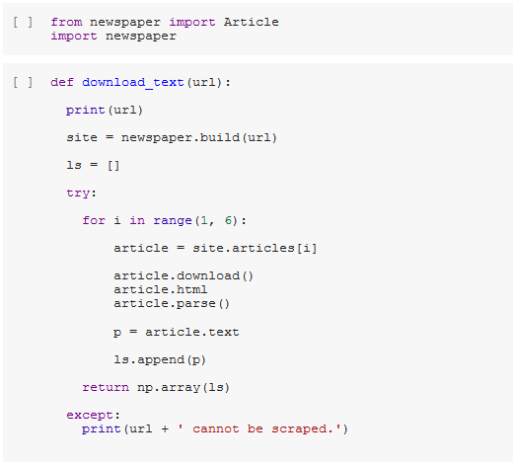
Data description
4595 articles from about 1000 news sites:
5 articles from each of the news sites listed in the MIT paper
Due to a variety of reasons, we could not get 5 articles from all the sites.
These articles were scraped using the Newspaper Python package (MIT data for text is anonymized)
22% of our dataset was labeled FAKE NEWS (by MIT research), so accuracy baseline is 78%.
Notes:
Qing
The MIT data is anonymized. There is no real context to the text analysis.

Slide 10
Our model
Logit with TF-IDF
Accuracy: 83.2%
5
articles
per
news
site
TF-IDF
SVM with TF-IDF
Bag of words
Data
Bag of words
Accuracy: 83.2%
~4500 x 2 matrix
~900 news sources
Used Pipeline and GridSearchCV to optimize model parameters, cv = 3
Notes:
Hariz

Slide 11
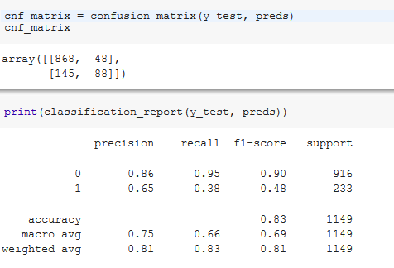
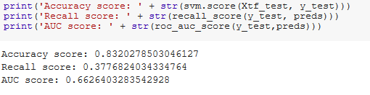
SVM outputs
Accuracy is higher than baseline of 78%.
Note: Linear kernel used for SVM model; ngram range = 2 used for TF-IDF
Notes:
Hariz

Slide 12
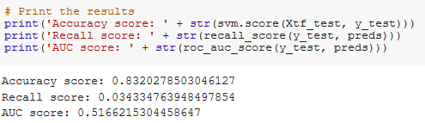
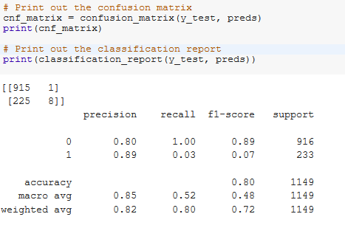
Logistic Regression outputs:
Accuracy is higher than baseline of 78%, but high number of false negatives.
Notes:
Hariz

Slide 13
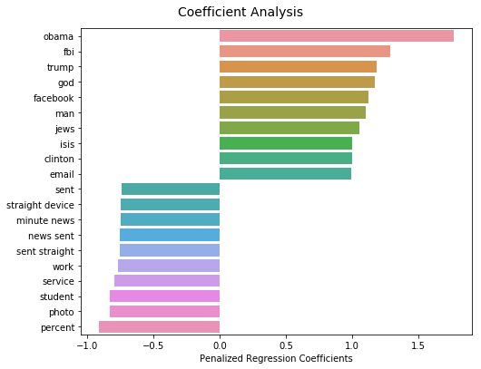
Results
For interpretability, we utilized a logit model to extract coefficients:
The word that contributes most to an article being fake news is ‘obama’, ‘fbi’, followed by ‘trump’.
The word that contributes most to an article not being fake news is ‘percent’, ‘photo’, followed by ‘student’.
Notes:
Kevin

Slide 14
Recap
Summary:
There are certain words or word patterns being used in fake news. These can be an indicator to help detect fact from false information.
Automated fake news detection is still a challenge without human eyes
Challenges:
Imbalanced data set
The factuality scale (low- med- high) is based on the Media Bias/ Fact Check website
Limited scraping ability (paywalls, foreign language news)
Foreign characters in the data
Further Improvements:
Including sentiment analysis
Including topic features
Notes:
Kevin

Slide 15
THANK YOU

Slide 16
Appendix

Slide 17
Link to notebook
Team Drive:
https://drive.google.com/drive/u/1/folders/0AKY70K5x3bOgUk9PVA
Notebook:
https://colab.research.google.com/drive/1DCvqtNqCPg1rY7uC2Sp-gla1Wz3_shAC?authuser=1#scrollTo=bNFMcXBADnxA

Slide 18
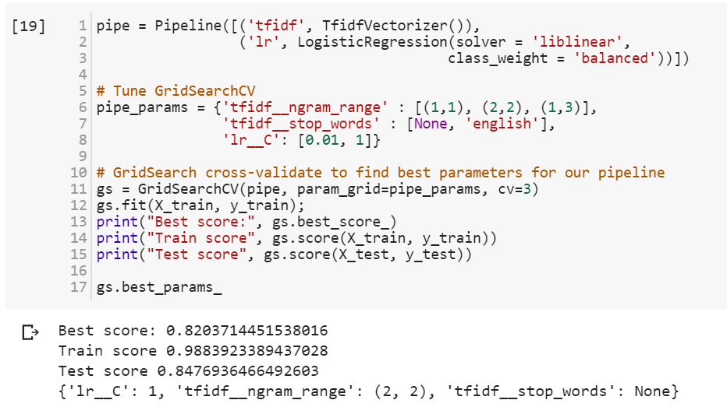
Example of GridSearchCV
Parameters to be optimized
Optimized parameters
Click me

Slide 19
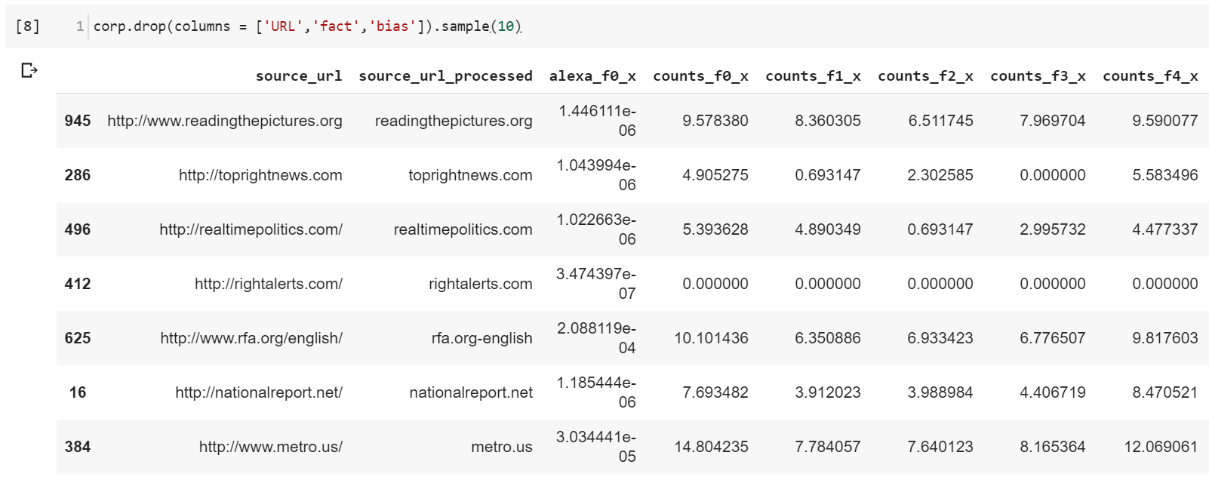
Sample of anonymized data
Click me

Slide 20
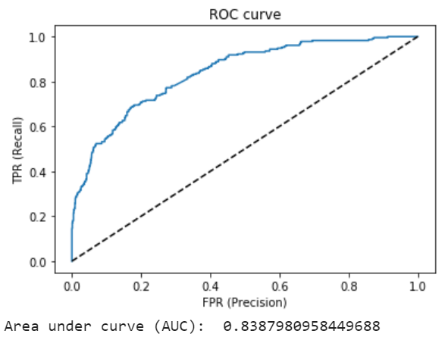
ROC Curve - SVM

Slide 21
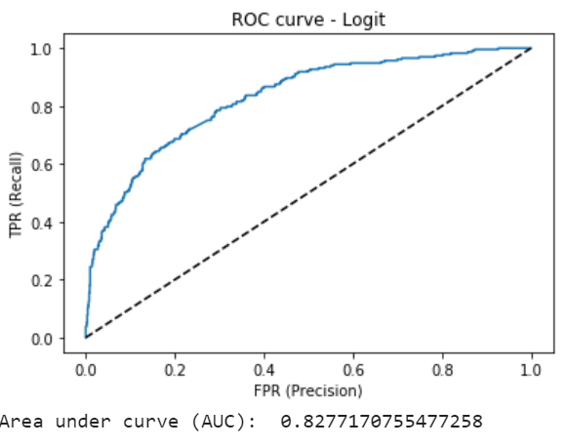
ROC Curve - Logit

Slide 22
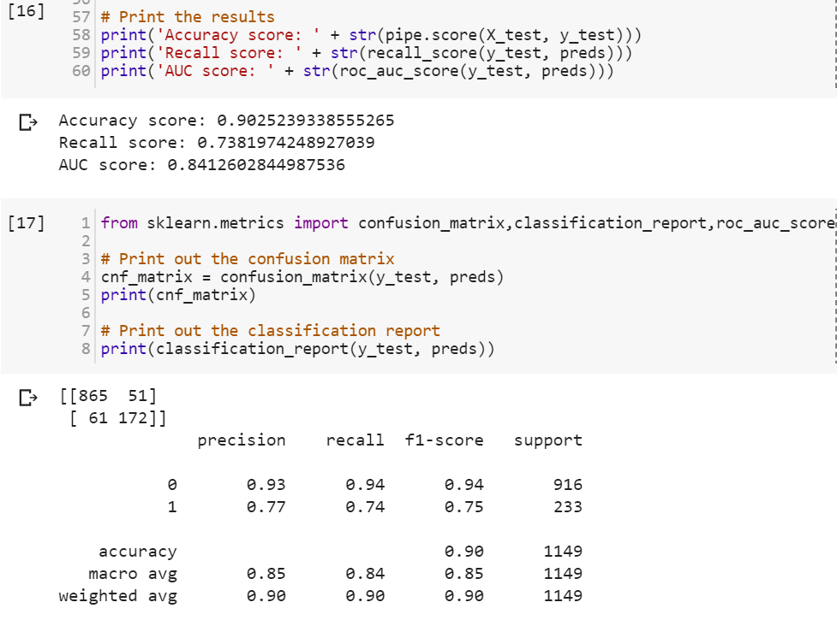
Additional models
We also implemented a logit model using a combined feature-set of the anonymized MIT data along with our scraped text data.
Link to notebook here

